Slide 1
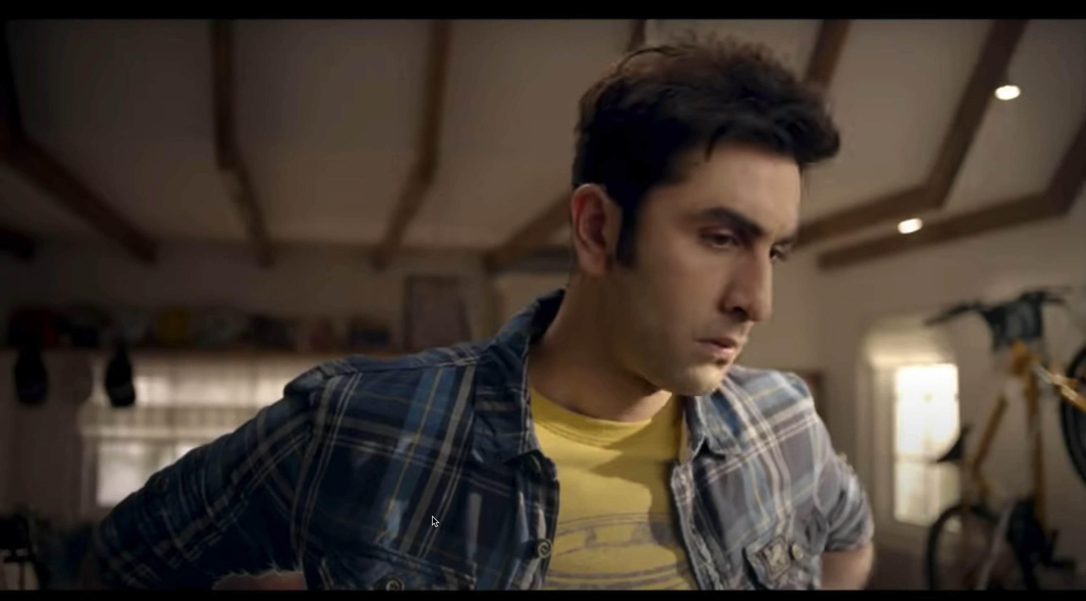
What are they fighting for ?
Notes:
Oreo

Slide 2
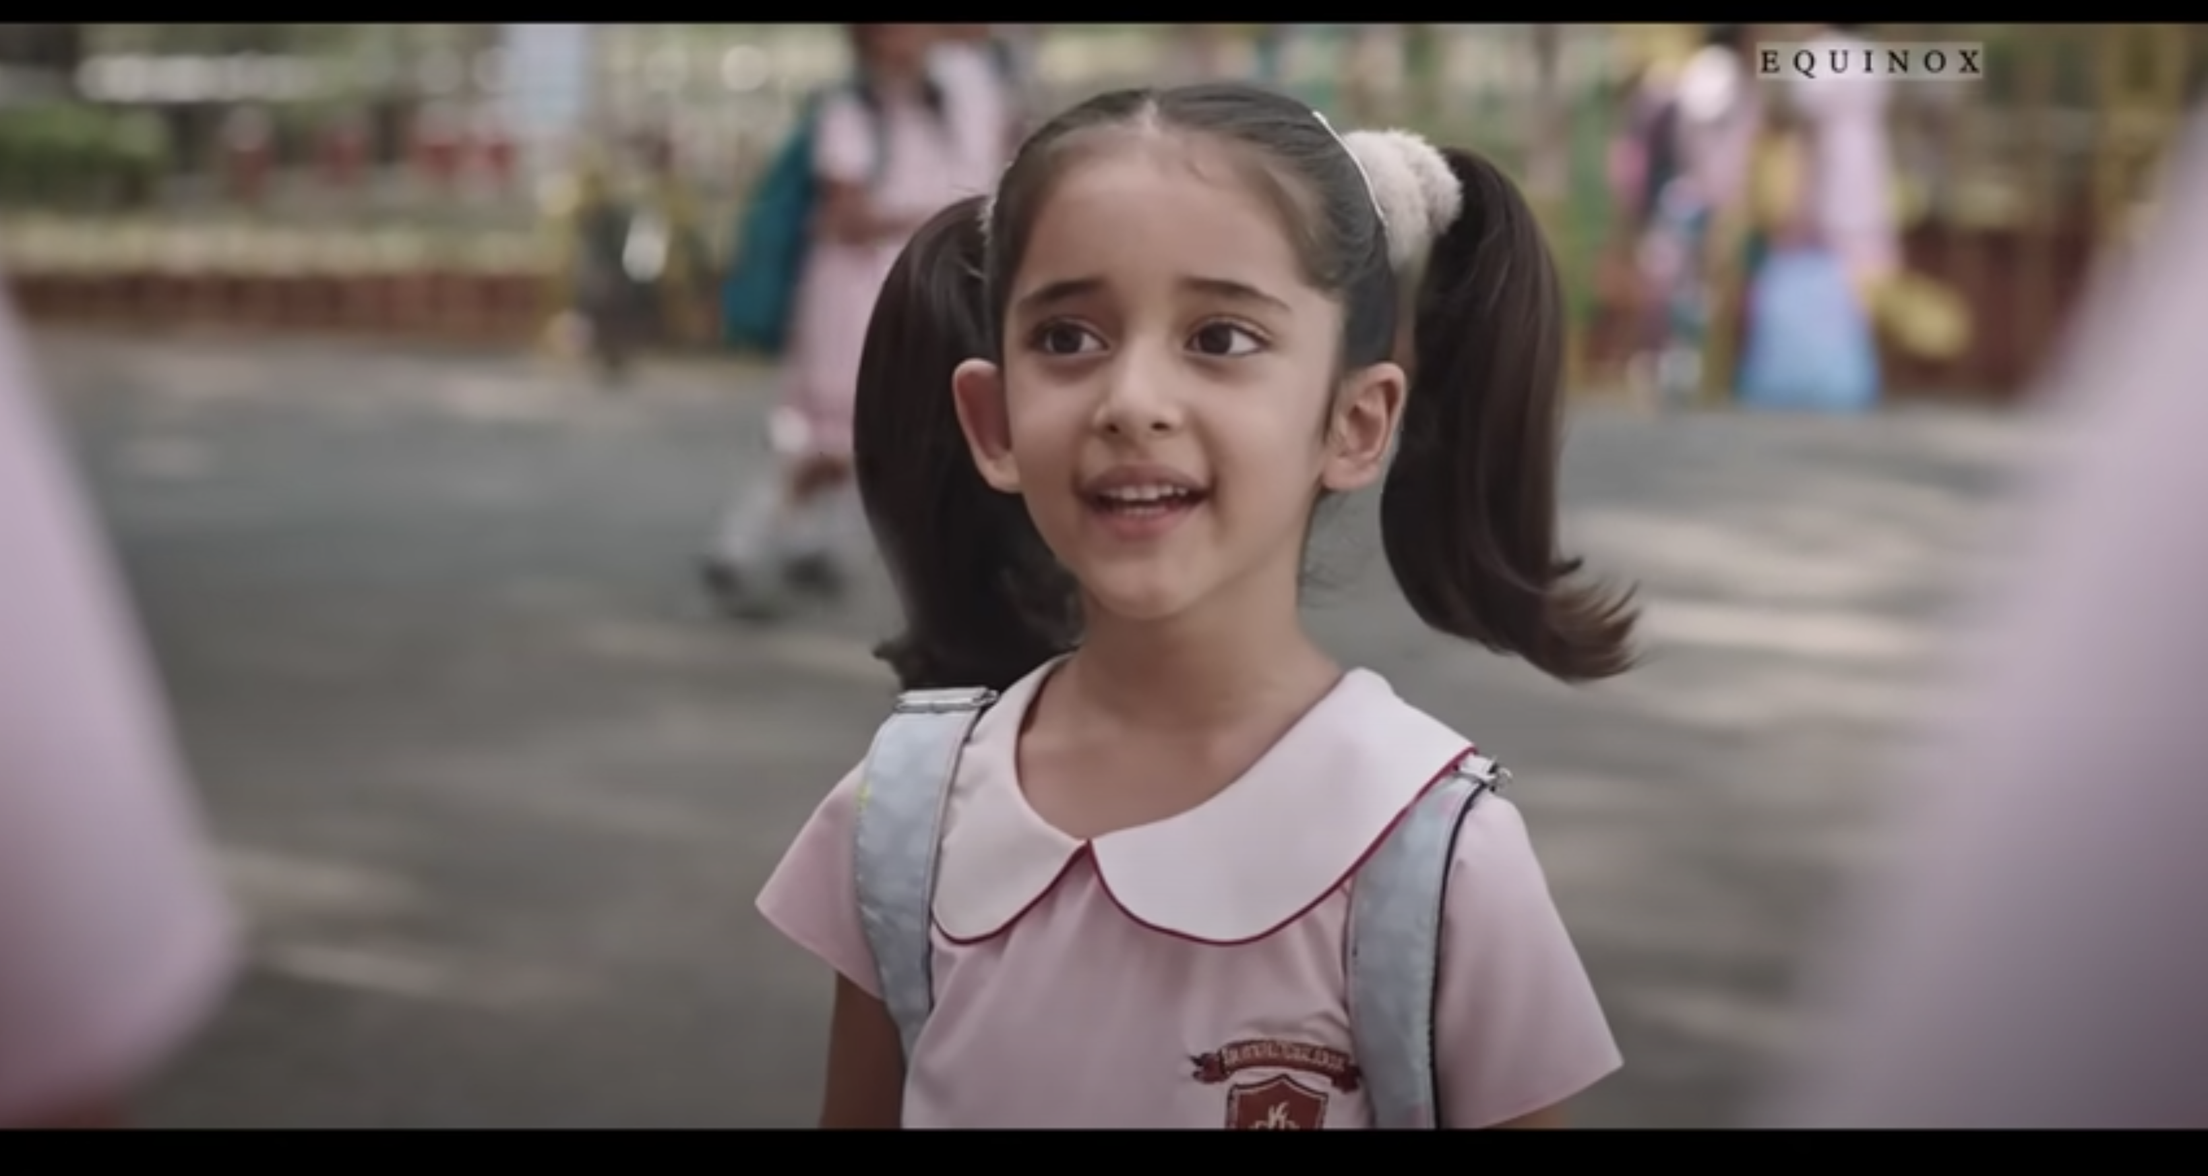
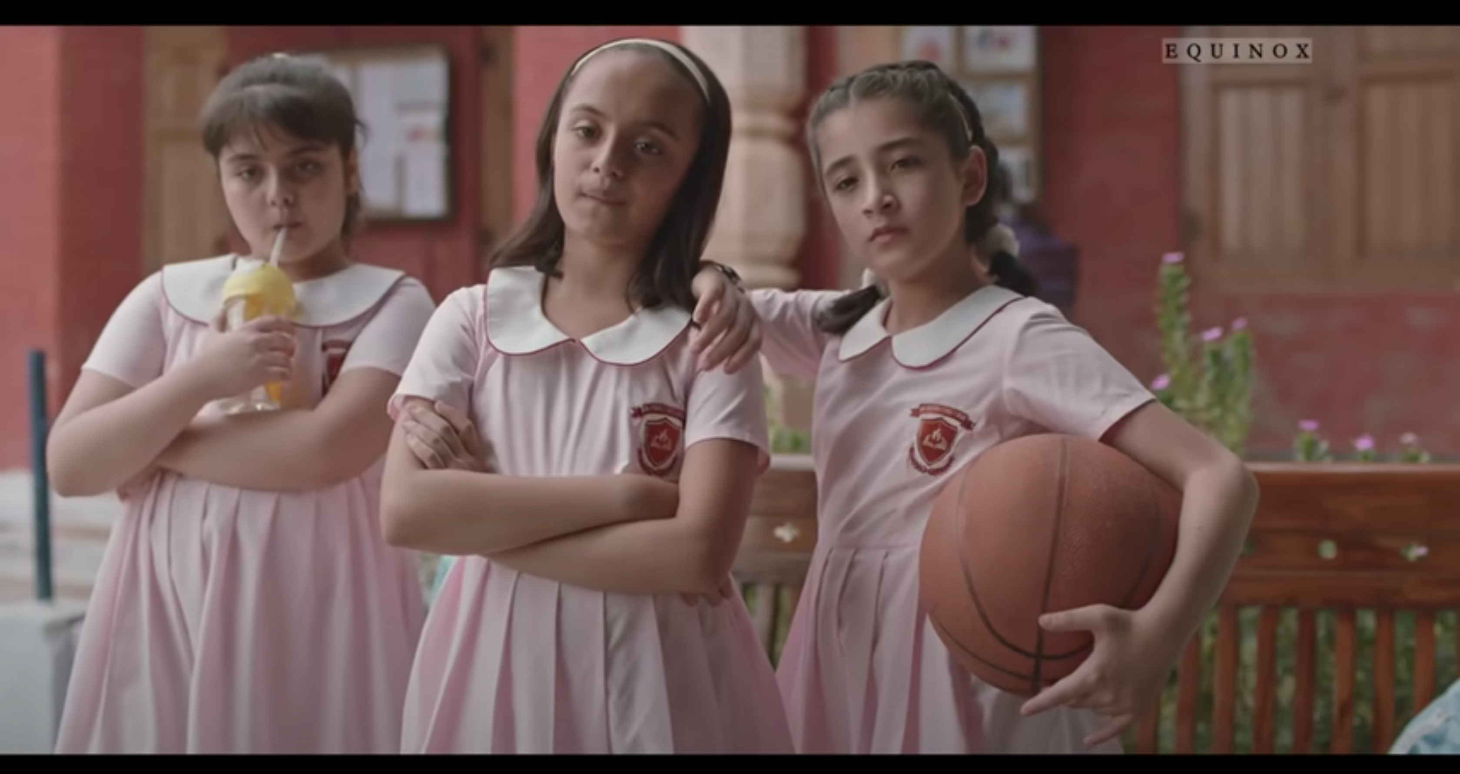
WHAT ARE THESE KIDS Discussing ?
Notes:
Colgate

Slide 3
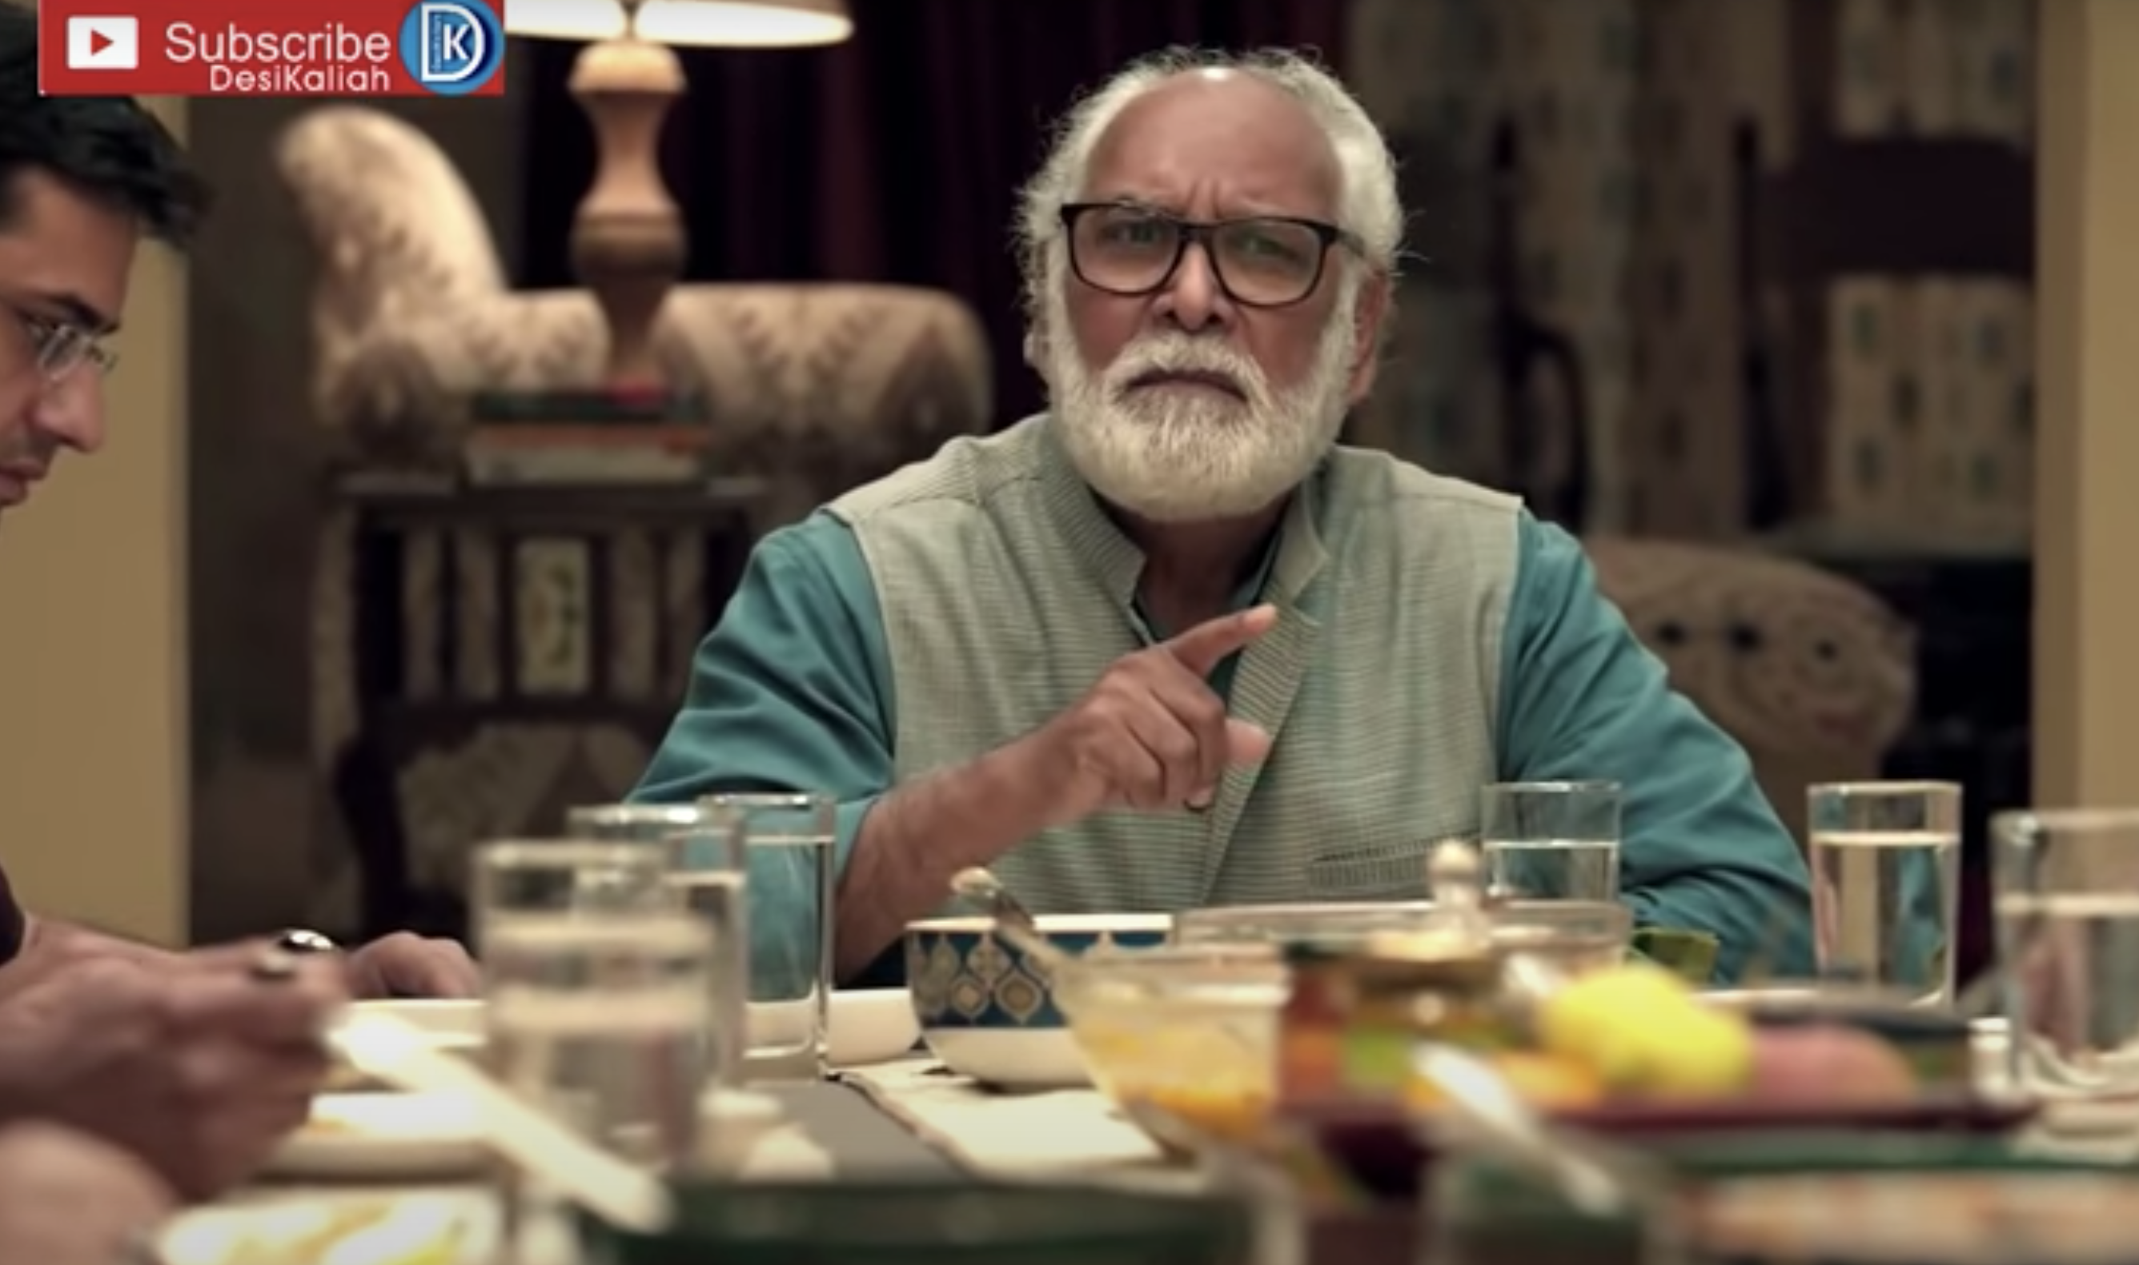
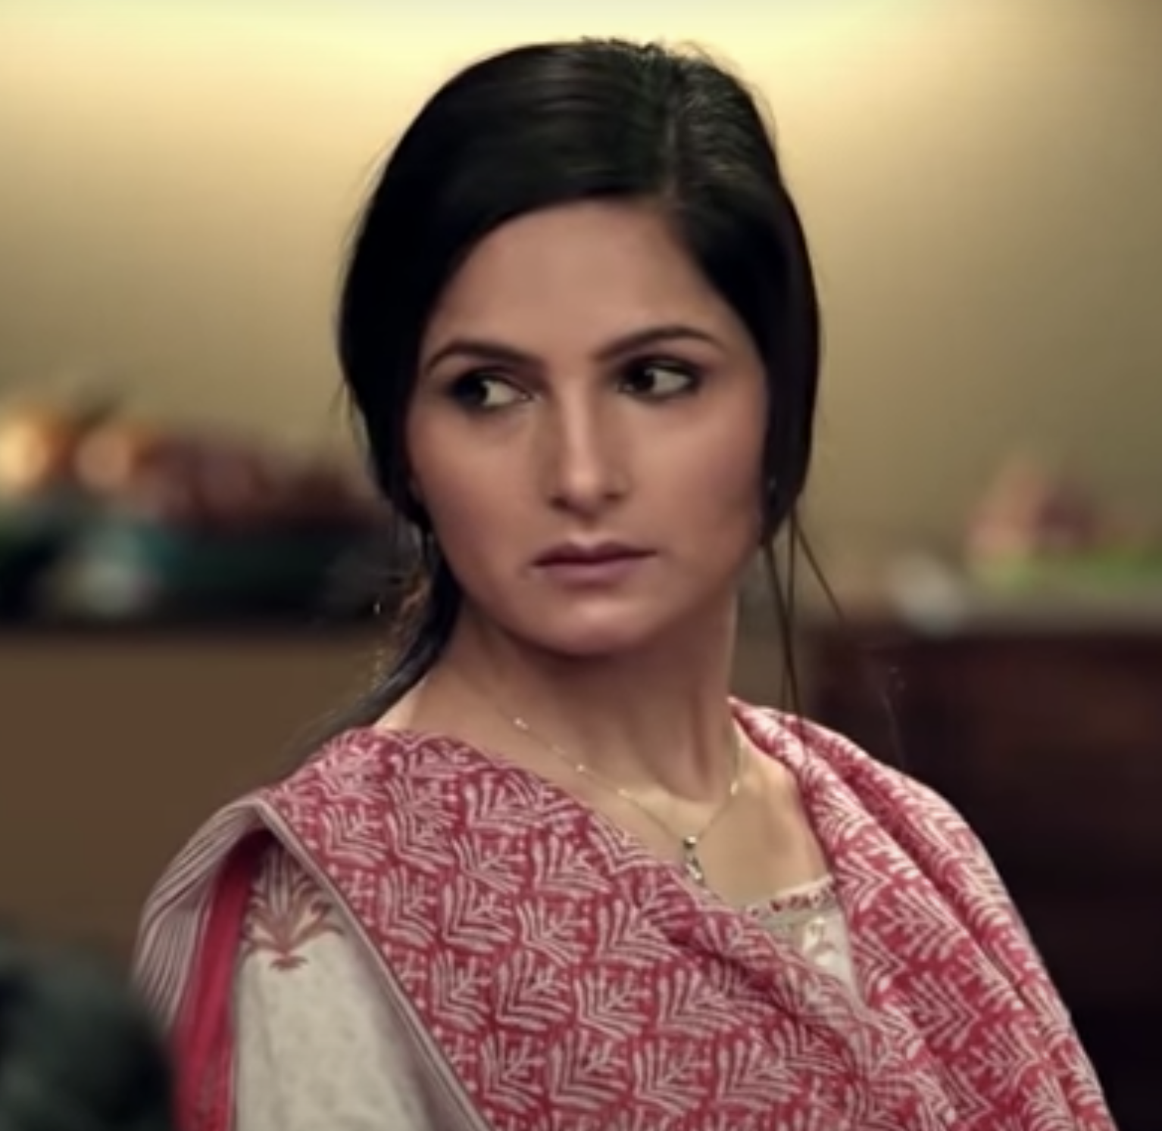
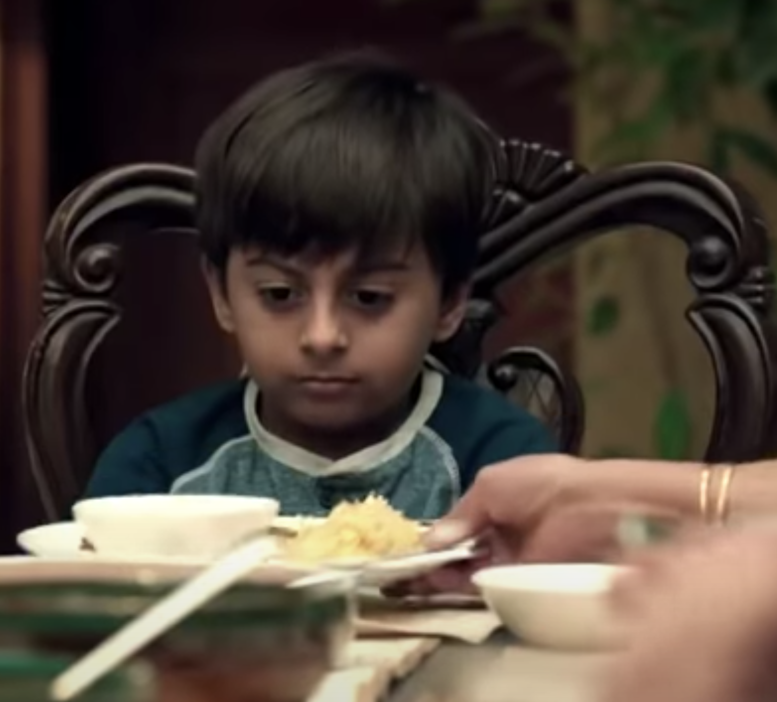
REMEMBER SOMETHING//? #STANDBYTOUGHMOM
Notes:
Good night

Slide 4

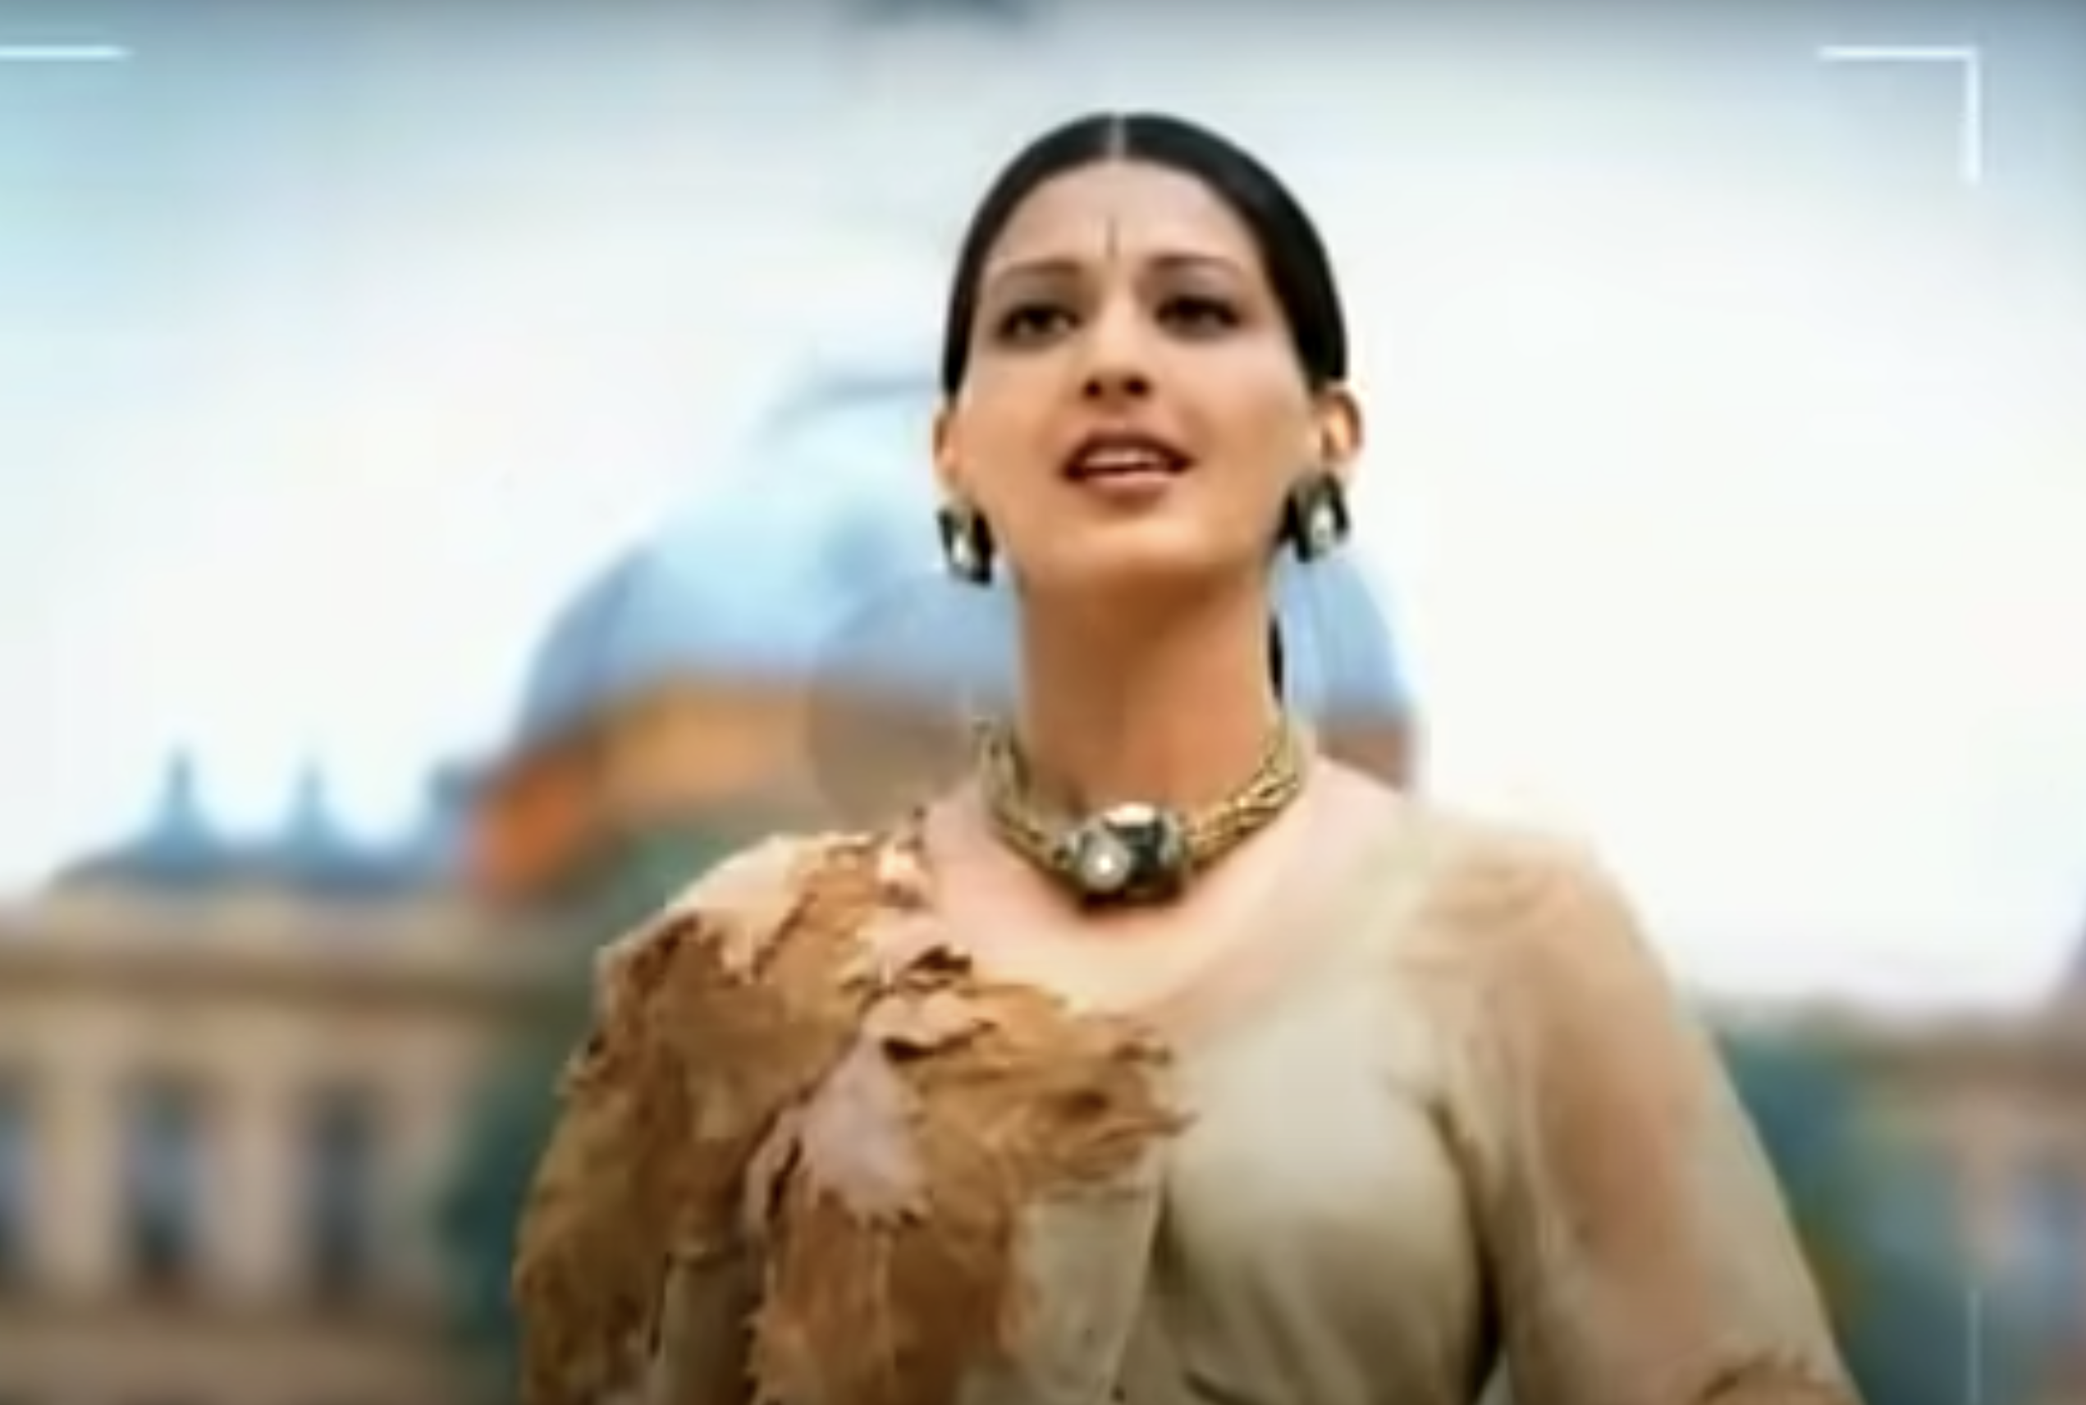
Identify this Soap commercial and Sing the jingle
Notes:
Nirma beauty soap

Slide 5
Identify this Brand using this Audio
Notes:
Center fresh

